Slide 1
Roman Legends and Roman Values
Alan Haffa
Please Silence your Cell Phone

Slide 2
Legends of Rome
Legend, Myth, and History
Ennius (239-169 B.C.): Father of Roman Poetry; Spoke Greek; Annals, an Epic that covers Roman history from Fall of Troy to Cato the Elder; Source for Vergil
Titus Livius (Livy) 59 B.C.-17 A.D.: Ab Urbe Condite (From the Founding of the City)
Prose Counterpart of Vergil as Golden Age Roman Literature
Vergil in the Aeneid; Ovid in Metamorphoses

Slide 3
Characteristics of Roman Myth
Focus on origins of City and Early History
Patriarchal Perspective
Demythologizing Tendency
Roman Transformation of Greek Myth
Politicizing of Myth

Slide 4
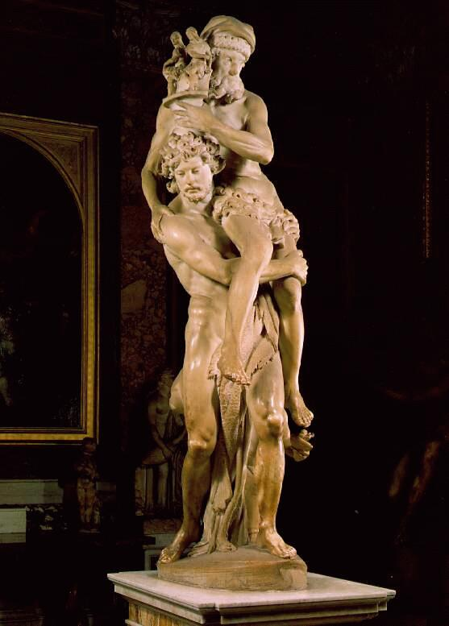
Roman Hero: Aeneas
Divinity of Julius Caesar and Augustus from Venus, through Iulus (Iulian line)
Pietas: Duty to family, State, and Religion
Gravitas: Seriousness of Purpose and Duty
Frugalitas: Ideal of Simple Life
Emotional Restraint
Subordination of Individual

Slide 5
Founding of Rome
Aeneas founded Lavinium, named after his wife, Lavinia; port city south of Rome
Ascanius/Iulus his son, founded Alba Longa
12 generation of Kings in Alba Longa led to Romulus and Remus, who founded Rome on seven hills on banks of river Tiber
Numitor and Amulius, brothers. Amulius drove brother into exile and killed sons by his daughter Rhea Silvia
Rhea Silvia made a Vestal Virgin

Slide 6
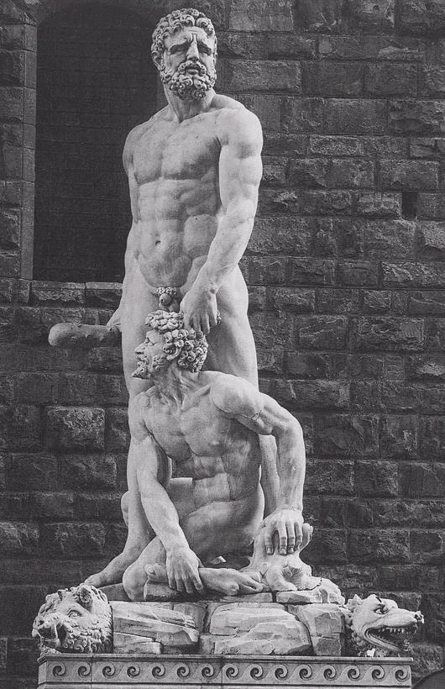
Hercules and Cacus
Cacus, a giant who had a cave on Mt. Aventine
Hercules Stole the cattle of Geryon; Cacus stole them from Hercules
Hercules is symbol of civilization who removed a troublesome thief
Ara Maxima founded at site of Forum Boarium, Cattle Market of Rome

Slide 7
Rhea Silvia and Romulus and Remus
She gave birth to twins and claimed rape by Mars
She was imprisoned in a dungeon to die and sons sent to be abandoned in the river
Rescued by wolves
Shepherd, Faustulus (Lucky), found them and brought them up with his wife Larentia.

Slide 8
Romulus and Remus
Fought and defeated Amulius
Romulus occupied Palatine Hill and Remus the Aventine
Augury Test: Remus’s portent: six vultures; Romulus: 12 vultures!
Remus jumped Romulus’ wall; Romulus killed Remus and said: “This is what will happen to anyone else who tries the same.”
Divine sanction of Rome; but also Fratricide
Notes:
Sing of gods; vultures. Remus saw 6; Romulus saw 12. Romulus killed brother for jumping over his wall.

Slide 9
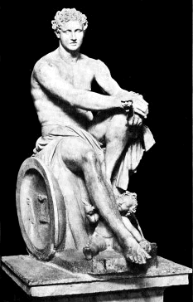
Romulus Deified as Quirinus
After 38 year rule Romulus disappeared
Some claimed Patrician foul play
Official Story: Taken to heaven as a god
Worshipped as Quirinus—a Sabine Storm God

Slide 10
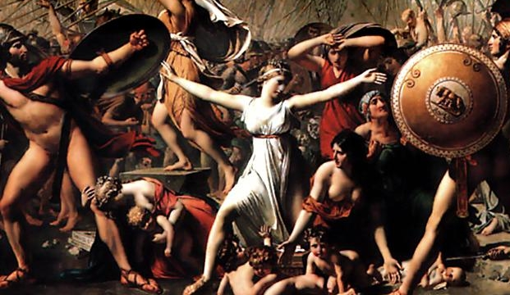
Rape of Sabine Women
Romulus invited Sabines to a festival
Bride Theft and Hospitality
Titus Tatius made war
Sabine women made peace
Cultural Context: Brides were taken from family homes under pretense of force and brought to groom’s home

Slide 11
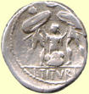
Traitorous Woman: Tarpeia
Father was defending the Capital Hill; she led Sabine army in a secret way
Betrayed Romans for “what is on your left arms”; bracelets
Bury her in shields
The place became the “rock of Tarpeia” and traitors were thrown off to their deaths there

Slide 12
6 Kings
Odd numbered: valiant and warlike; even numbered devoted to arts and peace
Romulus
Numa Pompilius: set up religious ceremonies
Tulius Hostilius, warrior
Ancus Marcius, new laws; joined Latins to Rome and built Tiber bridge
Tarquin the Elder (Etruscan)
Servius Tulluis: Constitution and built wall
Tarquin the Proud: cruel and tyrannical

Slide 13
Horatii vs Curiatii
Rome was fighting Alba Longa and agreed to settle it with a battle of three brothers
Two Horatii slain immediately
Third brother ran but as he was pursued he killed one and then a second Curiatii
Finally, one on one, he slew the last Curiatii brother
Lesson in Roman steadfastness
Returning home he saw his sister weeping; she had been married to a Curiatii He slew her in anger: “May every Roman woman die who laments and enemy!”
Tried and acquited of murder

Slide 14
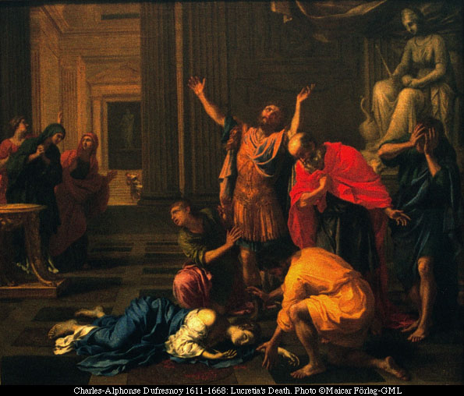
Rape of Lucretia
Contest of best wife: Lucretia busy at loom while others are feasting
Raped by Etruscan Prince, Sextus Tarquin
Livy, “They tell her it is the mind that sins, not the body; and that where purpose has been wanting there is no guilt. "It is for you to determine," she answers, "what is due to him, for my own part, though I acquit myself of the sin, I do not absolve myself from punishment; nor in time to come shall ever unchaste woman live through the example of Lucretia."

Slide 15
Brutus and his Son
Brutus was a friend of Lucretius’ husband; legendary ancestor of Brutus, who slew Julius Caesar to defend the Republic
He drew the dagger from her breast and swore to drive out the Tarquins
He and the husband o f Lucretia, Tarquin Collatinus, were first Consuls
His sons conspired with Tarquins and when caught, Brutus handed them over to Lictors, who whipped them with rods and beheaded them with axe.

Slide 16
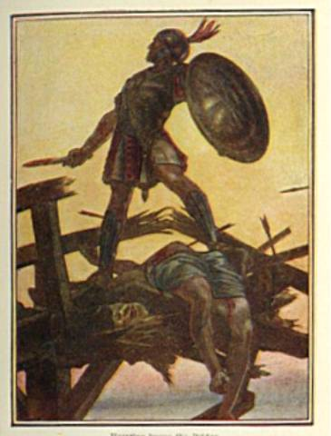
Horatius Cocles (One Eye)
Etruscans were approaching city
Defended the Sublican bridge
Prayer to Tiber: “Then Cocles said,.“Tiberinus, Holy Father, I pray thee to receive into thy propitious stream these arms and this warrior”
Symbol of Courage and Piety

Slide 17
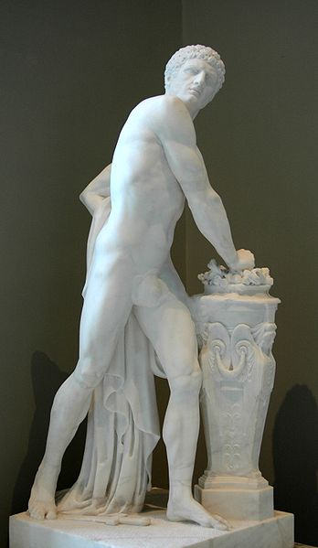
Mucius Scaevola (Lefty)
Attempted to steal into Etruscan camp
Assassination attempt against Lars Porsenna
Captured
Thrust his hand into fire in contempt of death
King let him go out of respect!
Thus Etruscans gave up war and left

Slide 18
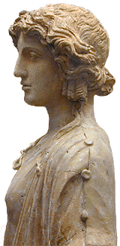
Cloelia and the Hostages
Peace Treaty: Roman hostages sent to Etruscans
Cloelia led women to escape
King so respected her bravery he allowed her to take more hostages back with her and she choose young men
Equestrian statue was erected in her honor on Sacred Way
Roman Women are as brave as Roman Men

Slide 19
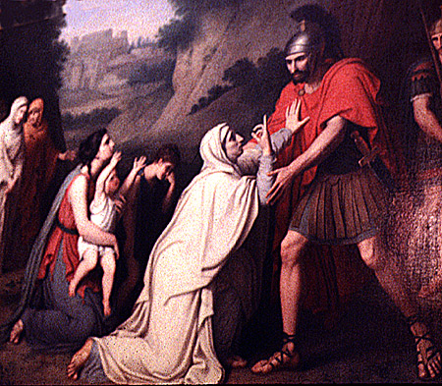
Coriolanus (named for Conquering
Leader of Rome; expelled as a tyrant by the Plebeians
Led the Volscian Army against Rome
Mother appealed to him not to attack; “my son, thou shalt enter Rome only over my dead body.” “Mother, thou hast saved Rome, and lost a son”
Killed by Volscians

Slide 20
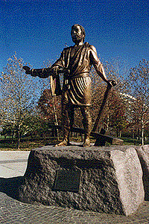
Cincinnatus
At work in fields, drops his plow to come to aid of Rome. Made Tyrant to fight Aequians
Upon winning the war he dropped his armor and picked up the plow again
Symbolized the simplicity of early Romans who valued patriotism but were not power hungry or greedy.

Slide 21
Observations on Roman Values
Pietas: Duty
Gravitas: Oath Keeping
Frugalitas: Simplicity
Fratricide a metaphor for conflict between Patricians and Plebeians
Role of Mother: Sacrifice and Loyalty (Tarpeia contrasts with Coriolanus’ Mother, Sabine Women, and Lucretia)

